Slide 1
Friday Training Hour
“PING Single Sign On”
… guest starring SAML, XML Encryption and OAuth 2
Anthony McKale
AI CoE Principal Software Engineer 15/05/2020

Slide 2
PING Single Sign On
FOR INTERNAL USE ONLY
MODIFIED TO REMOVE ALL RBS CONTENT
Table of Contents
Single Sign On Basics
PING brief overview
SAML 2.0
SNOW “code auth flow” overview
Will be aimed at the developer knowledge level
Information classiﬁcation: Public

Slide 3
Single Sign On Basics
FOR INTERNAL USE ONLY
Login in once, logged in everywhere
Actors
User : human accessing application
Requester : Application wanting to verify user and get user payload
Requestee : Application that can confirm the user is who they say they are, and can user permits access to payload / login
Ps Requester and Requestee can be separate machines / applications
Information classiﬁcation: Public

Slide 4
Single Sign On Basics
FOR INTERNAL USE ONLY
Login in once, logged in everywhere
Authentication Step involved
Authorisation Step involved
Proof of authentication/authorisation sent to requester
Application needs to remember the person is Logged in
* See Proxy servers training day
Information classiﬁcation: Public

Slide 5
Single Sign On Basics
FOR INTERNAL USE ONLY
Example of a browser based redirect SSO implementation
1) User goes to application website without being logged in
Application
Step
Authentication
Step
Authorisation
Step
2) Sent to Authentication
page
3) User logins in
Sent to Authorisation
page
4) User allows application
Sent back to Application Page
With Proof they are logged in
5) Application
Verifies the proof they are logged in
Stores the fact they are logged in
Information classiﬁcation: Public

Slide 6
SSO Basics: 2) Authentication Steps
FOR INTERNAL USE ONLY
Authentication Steps (aka logging in)
Login can be done automatically or manually
Automatic login mechanisms can include physical USB tokens or via network using corporate proxy servers* or mobile phone specific headers
Manual log in mechanisms are the normal username and password * some times 2 factor authentication is used, see bank customer login, involving both
See Proxy servers training day
Important :
Requester doesn’t need to know Authentication or Authorisation steps
Information classiﬁcation: Public

Slide 7
SSO Basics: 3) Authorisation Steps
FOR INTERNAL USE ONLY
Authorisation Steps (aka getting permission for actions)
Authorisation can be done automatically or manually
Automatic authorisation :
could be pre-set based on requester application’s permissions
defaults the user as set with the requestee
Manual authorisation examples :
allow page, permissions are granted to the requester application
2nd communication channel ( for bank user could be mail or phone verification of permissions changes )
Important :
Requester doesn’t need to know Authentication or Authorisation steps
Information classiﬁcation: Public

Slide 8
SSO Basics: 4) Proof
FOR INTERNAL USE ONLY
Common security and proof mechanisms:
Crypto-signing of requests and responses in SSO
Encryption of sensitive payloads
Firewalls blocking requests from unknown 3rd parties
Locked down return endpoints to prevent leaking of data
Information classiﬁcation: Public

Slide 9
Single Sign On Basics: Persistence
FOR INTERNAL USE ONLY
Common application persistence mechanisms:
Payload typically can be meta data or access token which are stored against a user unique id
Payload Handling
Sensitive metadata often encrypted at rest (rest = when not being used and is being stored)
Often sensitive tokens are one time hashed if they are not actually needed in plain text
Sensitive access tokens often expire so need to be requested
Information classiﬁcation: Public

Slide 10
Questions ?
FOR INTERNAL USE ONLY
Information classiﬁcation: Public

Slide 11
PING: brief overview
FOR INTERNAL USE ONLY
RBS’s strategic SSO platform, is PING federate
PING federate using the SAML SSO* standard
https://www.pingidentity.com/en/software/pingfederate.html
https://en.wikipedia.org/wiki/SAML_2.0
* PING does supports lots more mechanisms like Oauth2 but is configured to use SAML 2.0
Information classiﬁcation: Public

Slide 12
PING : Diagram
FOR INTERNAL USE ONLY
PING Browser based redirect SSO implementation
Example :
xxx/sso/start
1) User goes to application website without being logged in
Application
Step
Authentication
Step
Authorisation
Step
2) Authentication
page
3) Authentication
Based on User’s Browser / Proxy Setup
4) Authorisation
Based on Requestee Application
Sent back to Application Page
With Signed metadata payload
5) Application
Verifies the proof they are logged in
Stores the fact they are logged in
Information classiﬁcation: Public

Slide 13
PING: Technical Details
FOR INTERNAL USE ONLY
Technical Details
1) User goes to Application server
2) redirect to auth ping server (optional RelayState)
https://AUTH_SERVER/idp/startSSO.ping?PartnerSpId=XXX
[&RelayState=YYY]
3) SAML / PING MAGIC
see https://en.wikipedia.org/wiki/SAML_2.0#SP_redirect_request;_IdP_POST_response
4) Ping server posts to pre-configured endpoint
POST BODY:
SAMLResponse: base64 encoded XML string [Optional RelayState: YYY]
Information classiﬁcation: Public

Slide 14
Questions ?
FOR INTERNAL USE ONLY
Information classiﬁcation: Public

Slide 15
SAML 2.0
FOR INTERNAL USE ONLY
Security Assertion Markup Language 2.0 from 2005
https://en.wikipedia.org/wiki/SAML_2.0
Contains :
Protocols
Bindings
Profiles
Metadata Spec
Complex only going to talk about idP SSO details
Information classiﬁcation: Public

Slide 16
SAML 2.0: protocol
FOR INTERNAL USE ONLY
+ HTTP POST Binding
+ Web browser SSO profile
SAML 2.0 XML Payloads
CONTINUE TALK HERE
https://en.wikipedia.org/wiki/SAML_2.0#Web_browser_SSO_profile
Information classiﬁcation: Public

Slide 17
SAML 2.0: protocol
FOR INTERNAL USE ONLY
CONTINUE TALK HERE
Information classiﬁcation: Public

Slide 18
SAML 2.0: (XML) format
FOR INTERNAL USE ONLY
SAML is XML based ( like HTML )
Main “Elements / Tags” available :
“Signatures” following xml encryption standard*
“Subject” containing id
“Conditions” basically information expiry info
“AttributeStatements” metadata
And the payload is signed using the “xml encryption standard”, to verify it’s coming from PING and not a man in the middle
* https://en.wikipedia.org/wiki/XML_Encryption
Information classiﬁcation: Public

Slide 19
SAML 2.0: Example Signatures
FOR INTERNAL USE ONLY
Note public signing key will be provided by PING team
WARNING: very brittle, signing is of received exact string, any normalisation of the xml string will be signature
Information classiﬁcation: Public

Slide 20
SAML 2.0: signing / parsing
FOR INTERNAL USE ONLY
You can verify signing using xml-enc* + PING public certs
* https://en.wikipedia.org/wiki/XML_Encryption
Information classiﬁcation: Public

Slide 21
PING + SAML 2.0: Worked Example
FOR INTERNAL USE ONLY
https://rbs-chatbot-gateway-dev.eu-gb.mybluemix.net/sso/start
Information classiﬁcation: Public

Slide 22
Questions ?
FOR INTERNAL USE ONLY
Information classiﬁcation: Public

Slide 23
OAuth 2 “Auth Code Flow”
FOR INTERNAL USE ONLY
GOTO OLD TECH ARCHITECTURE TALK
https://auth0.com/docs/flows/concepts/auth-code
Information classiﬁcation: Public

Slide 24
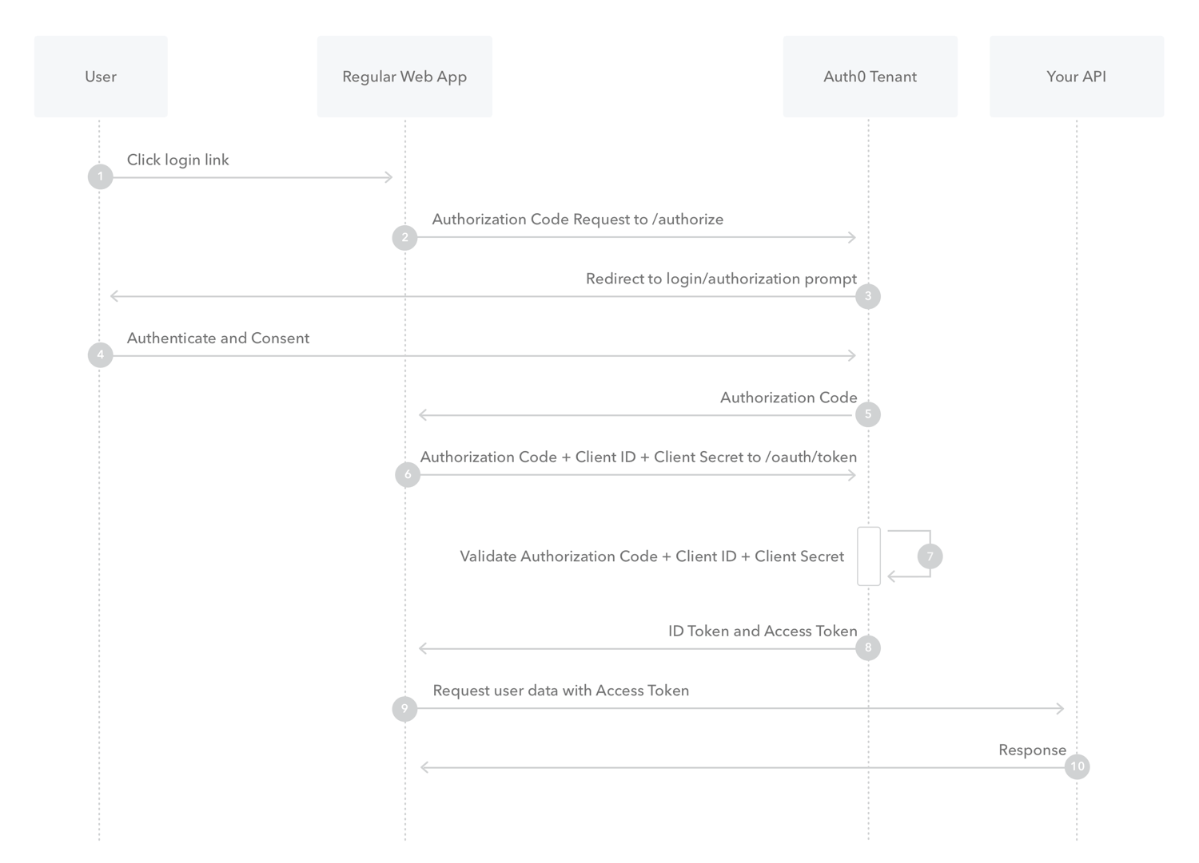
OAuth 2 “Auth Code Flow”
FOR INTERNAL USE ONLY
GOTO OLD TECH ARCHITECTURE TALK
https://auth0.com/docs/flows/concepts/auth-code
THE COME BACK
Information classiﬁcation: Public

Slide 25
OAuth 2 “Auth Code Flow”
FOR INTERNAL USE ONLY
Basic points :
- Same stuff
- Different day
Information classiﬁcation: Public

Slide 26
Questions ?
FOR INTERNAL USE ONLY
Information classiﬁcation: Public

Slide 27
Questions ?
FOR INTERNAL USE ONLY
I’ve been Anthony M^{c}Kale “Wizard without Portfolio” Fixer-Upper of Broken things, and creator of time-constrained workable Fudges for 15 years. Email : anthony@zapper.hodgers.com
Information classiﬁcation: Public

Slide 28
FOR INTERNAL USE ONLY
Thank you
Information classiﬁcation: Public

